Slide 1
Mapping Accumulated Heat and Plant Phenology Data
Karlee Bradley
Data Visualization Intern
July 31, 2019

Slide 2
Overview
NEON tutorials and other program tutorials
Plant phenology and AGDDs
Getting to know the data
Initial shiny apps
Data story
Final products
About me!

Slide 3
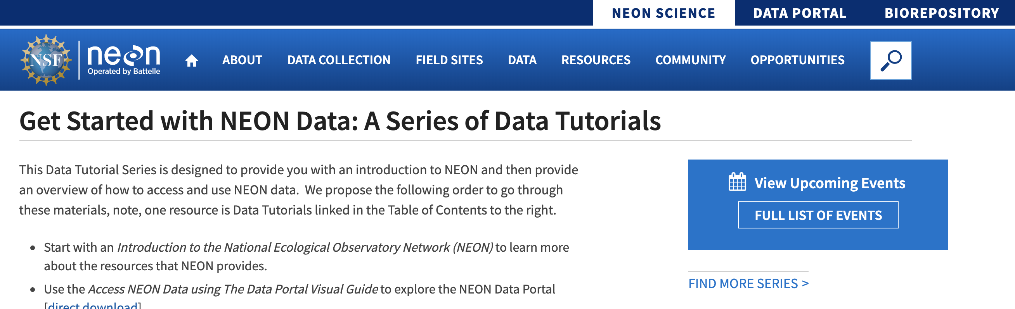
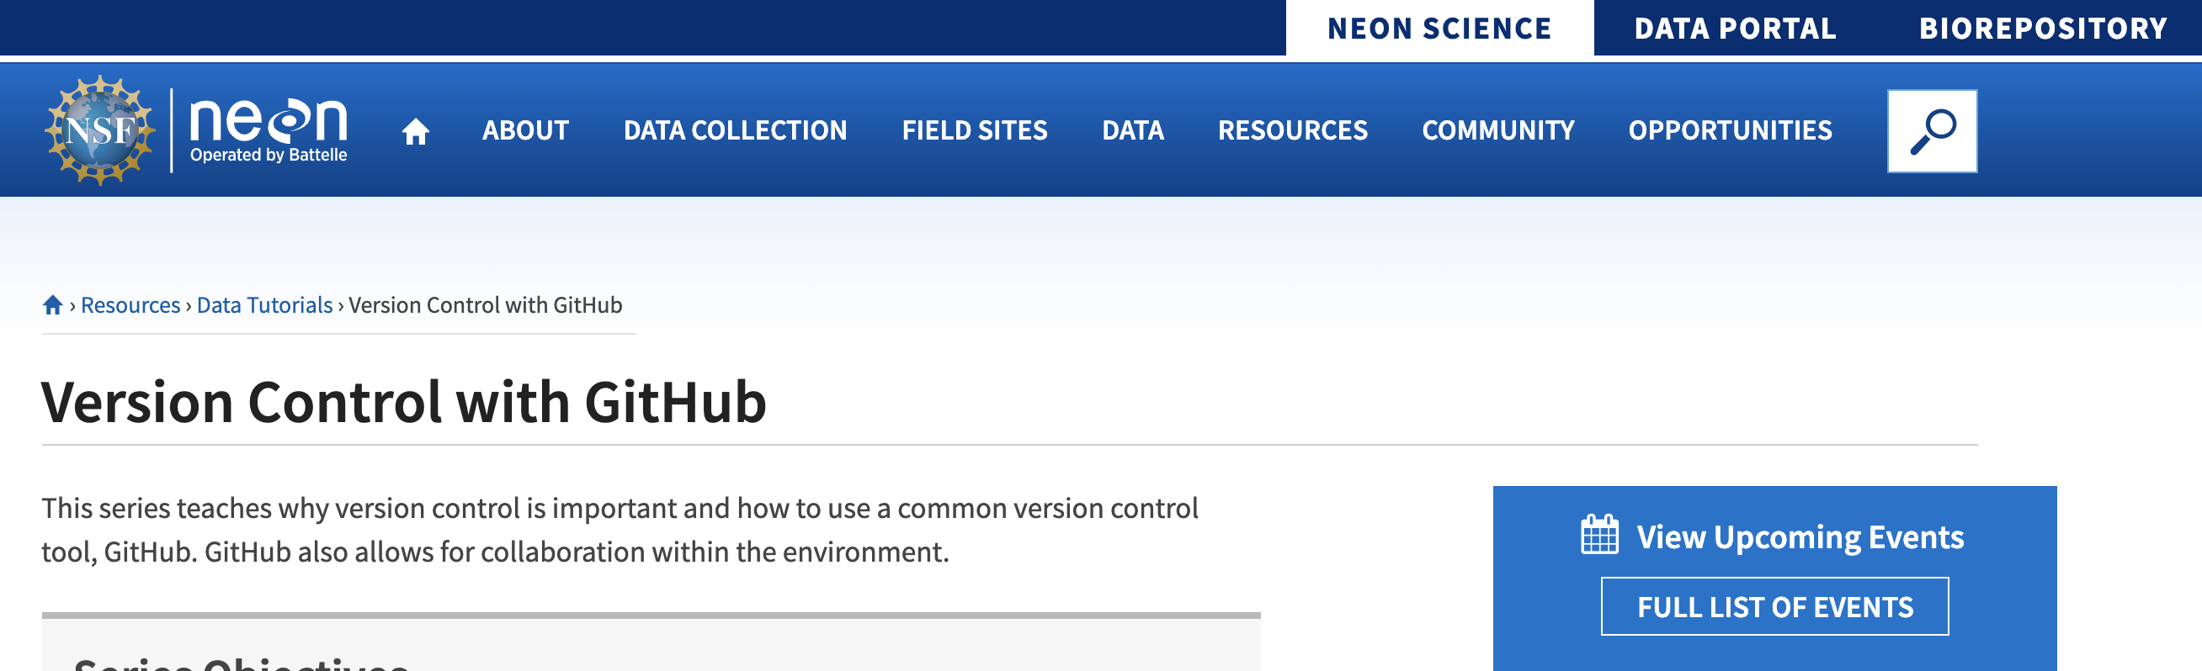
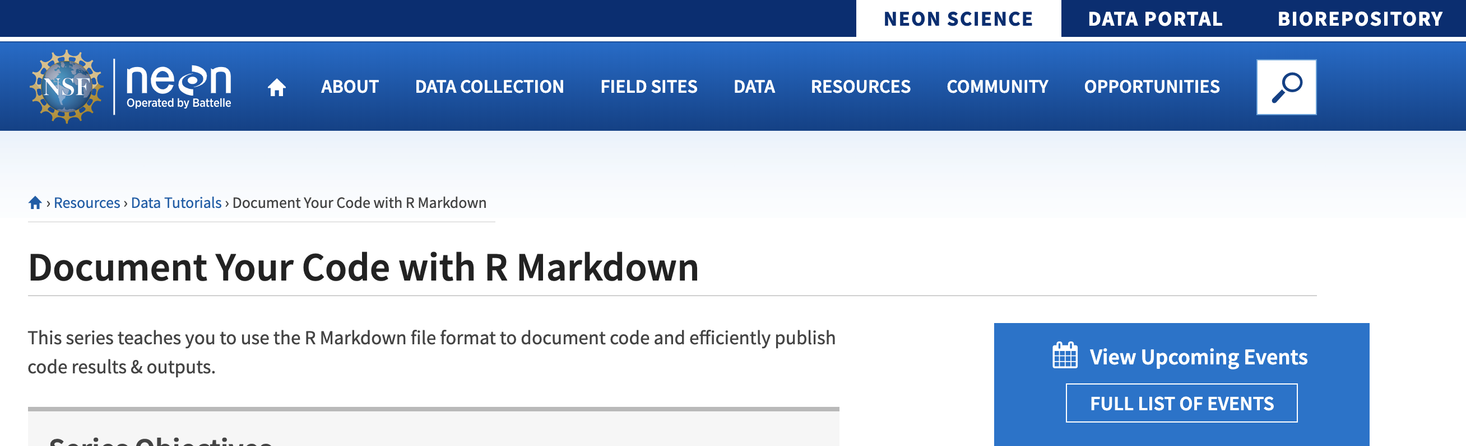
Tutorials and New Programs

Slide 4
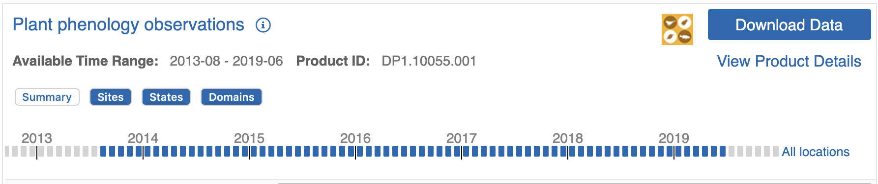
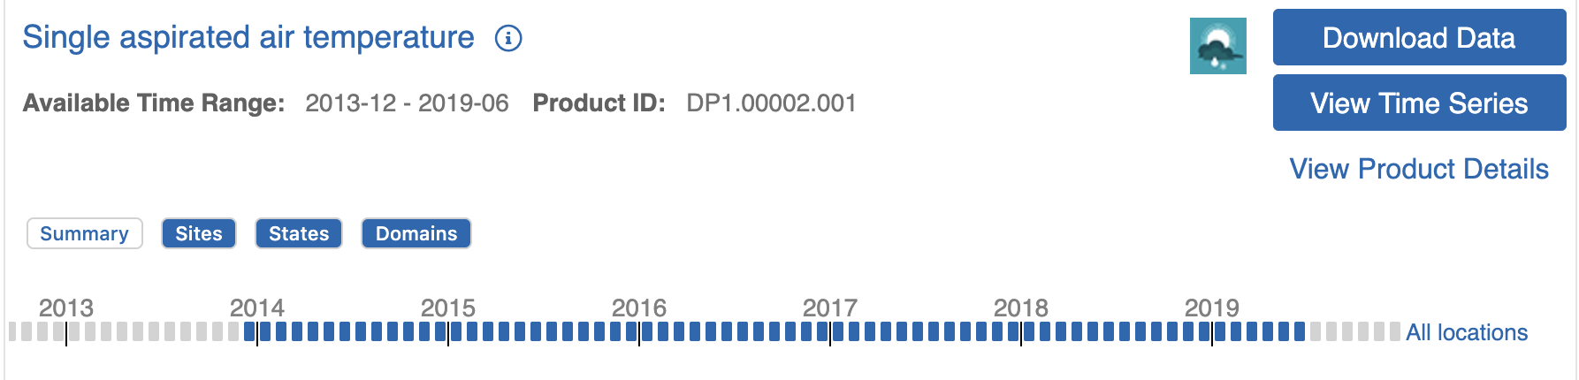
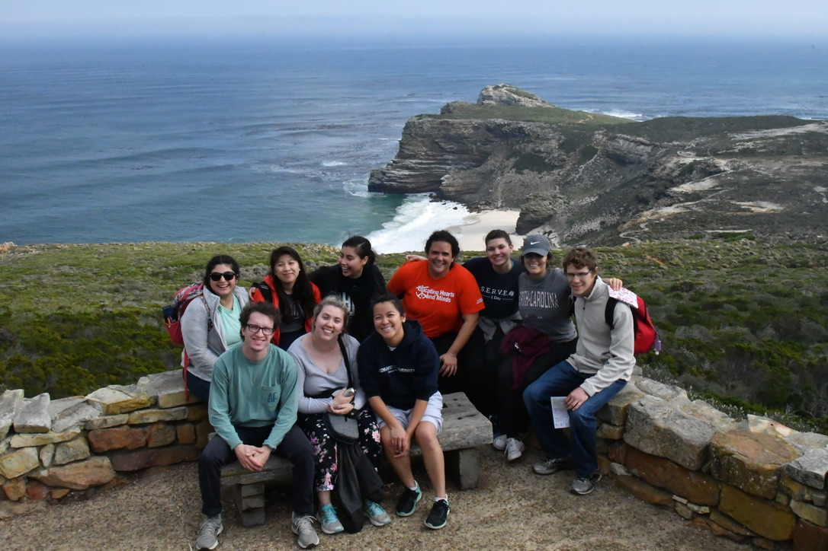
Project Ideas

Slide 5
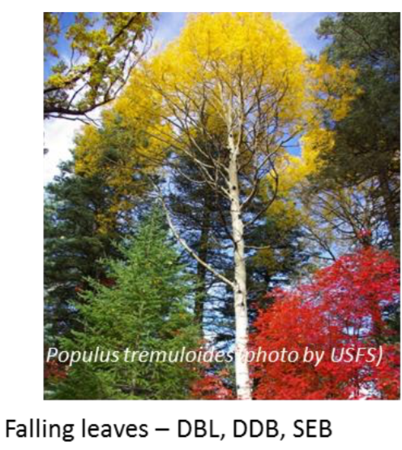
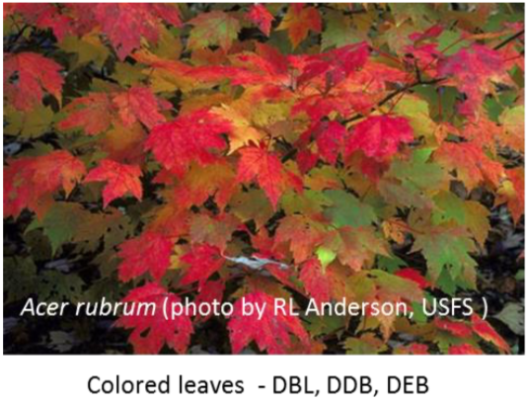
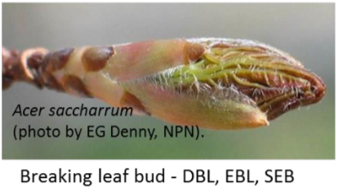
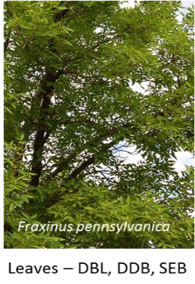
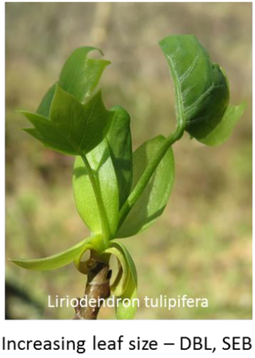
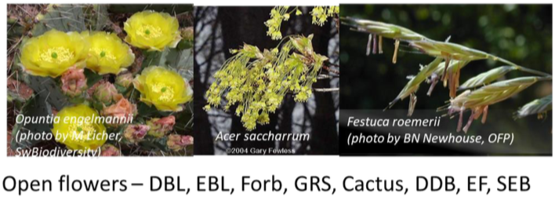
Definitions
Phenology: the study of cyclic and seasonal natural phenomena
Plant phenology: the transition of plants through phenophases

Slide 6
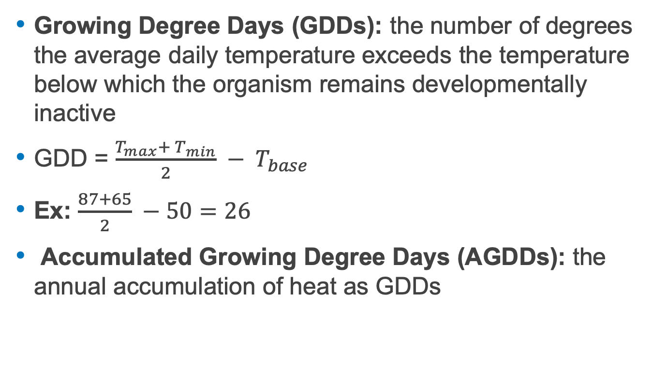
Definitions
Growing Degree Days (GDDs): the number of degrees the average daily temperature exceeds the temperature below which the organism remains developmentally inactive
GDD = $\frac{T_{max}+ T_{min}}{2} − T_{base}$
Ex: $\frac{87+65}{2} −50=26$
Accumulated Growing Degree Days (AGDDs): the annual accumulation of heat as GDDs

Slide 7
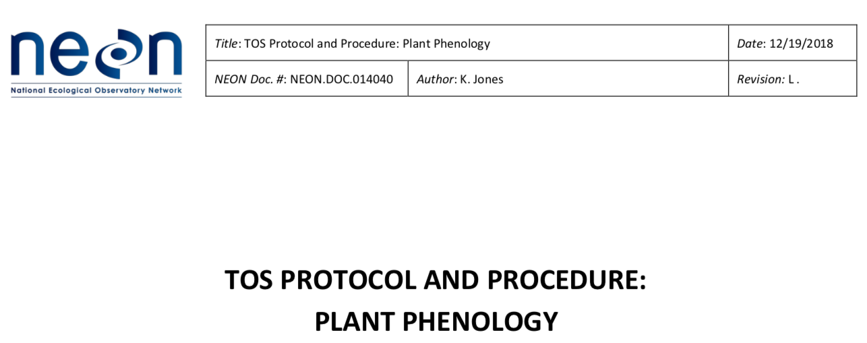
Getting to Know Plant Phenology and AGDDs

Slide 8

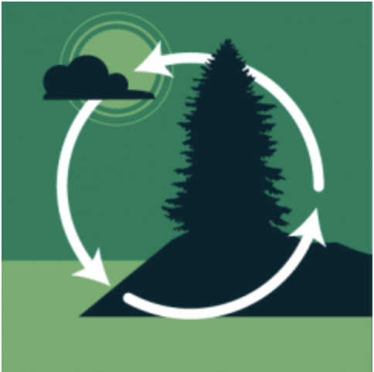
Playing with Data and Doing Research
Stephanie Parker: aquatic ecosystems
Katie LeVan: insects (gypsy moth)
Lee Stanish: microbes

Slide 9
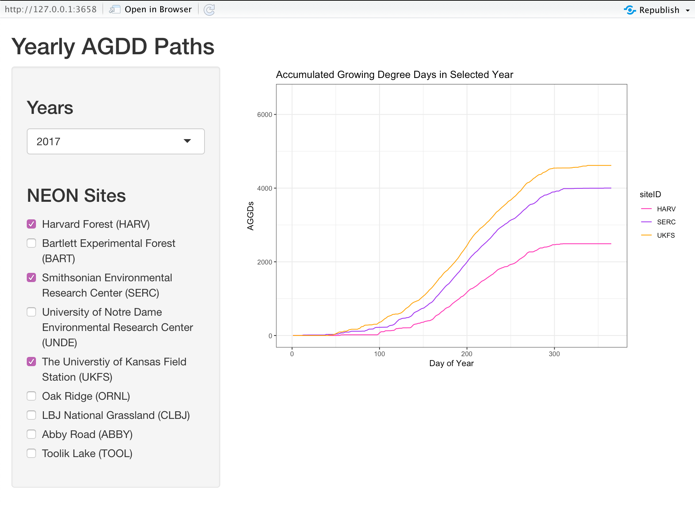
Shiny Apps
AGDD-path

Slide 10
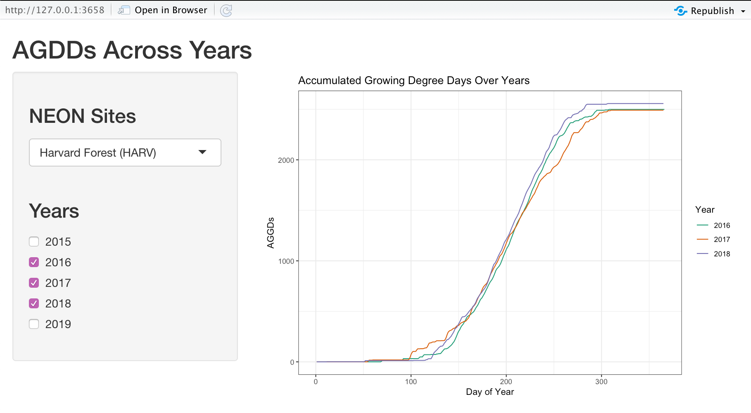
Shiny Apps
AGDD-years

Slide 11
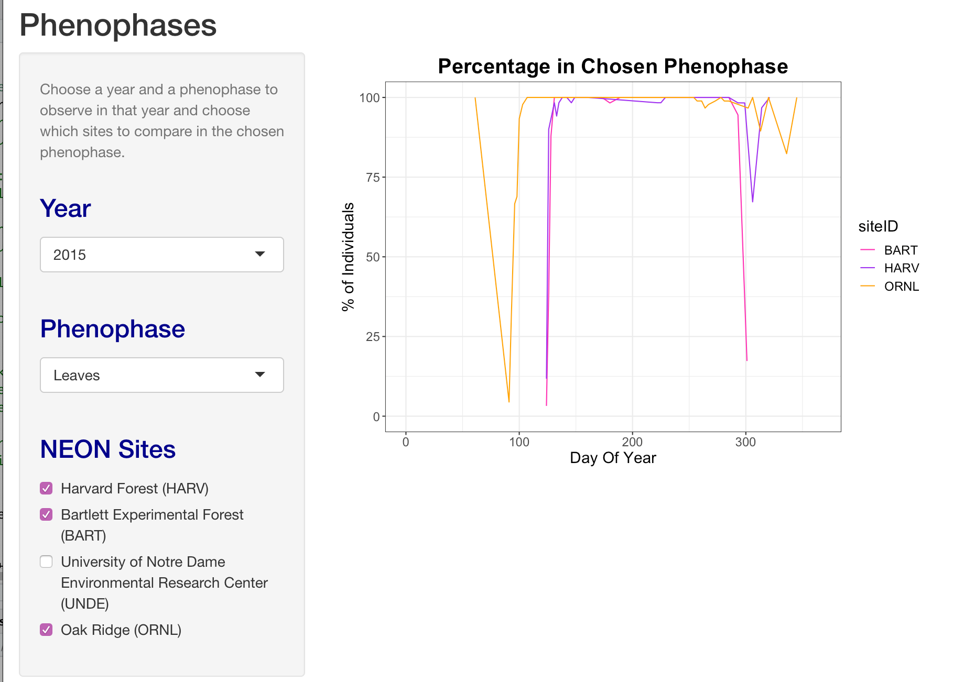
Shiny Apps
Pheno-line

Slide 12
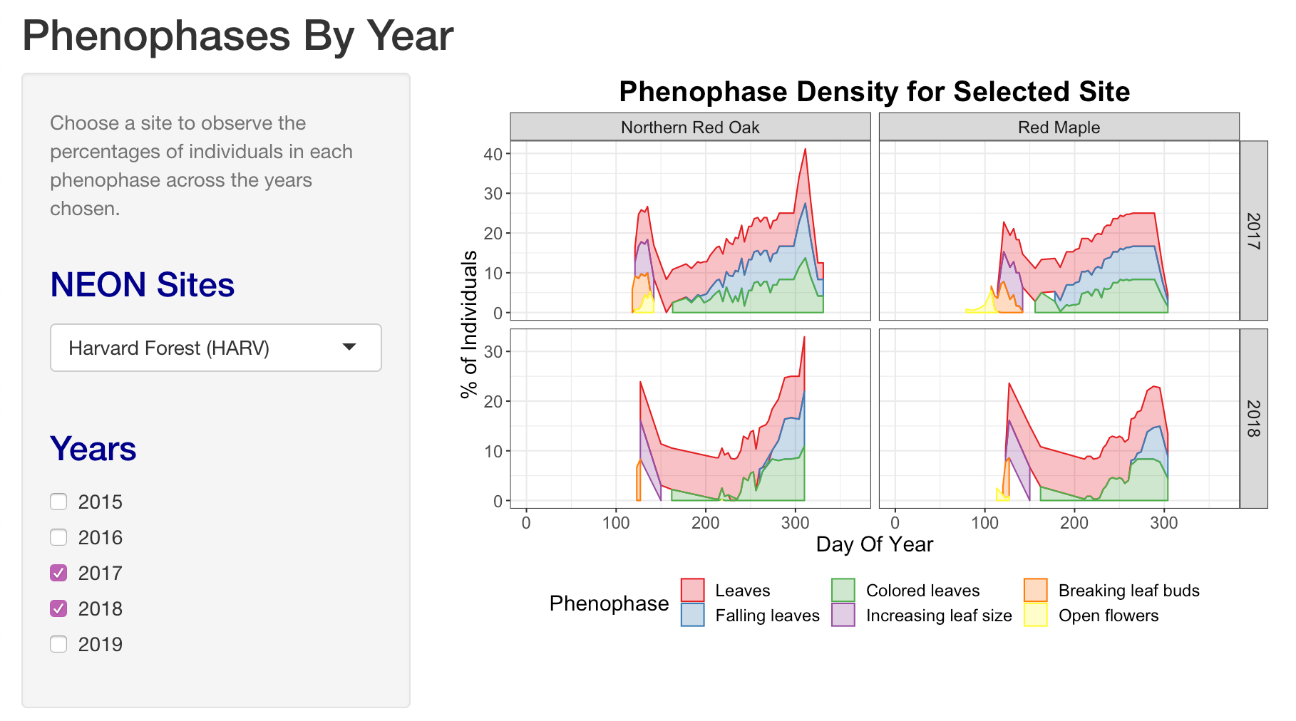
Shiny Apps
Pheno-area

Slide 13
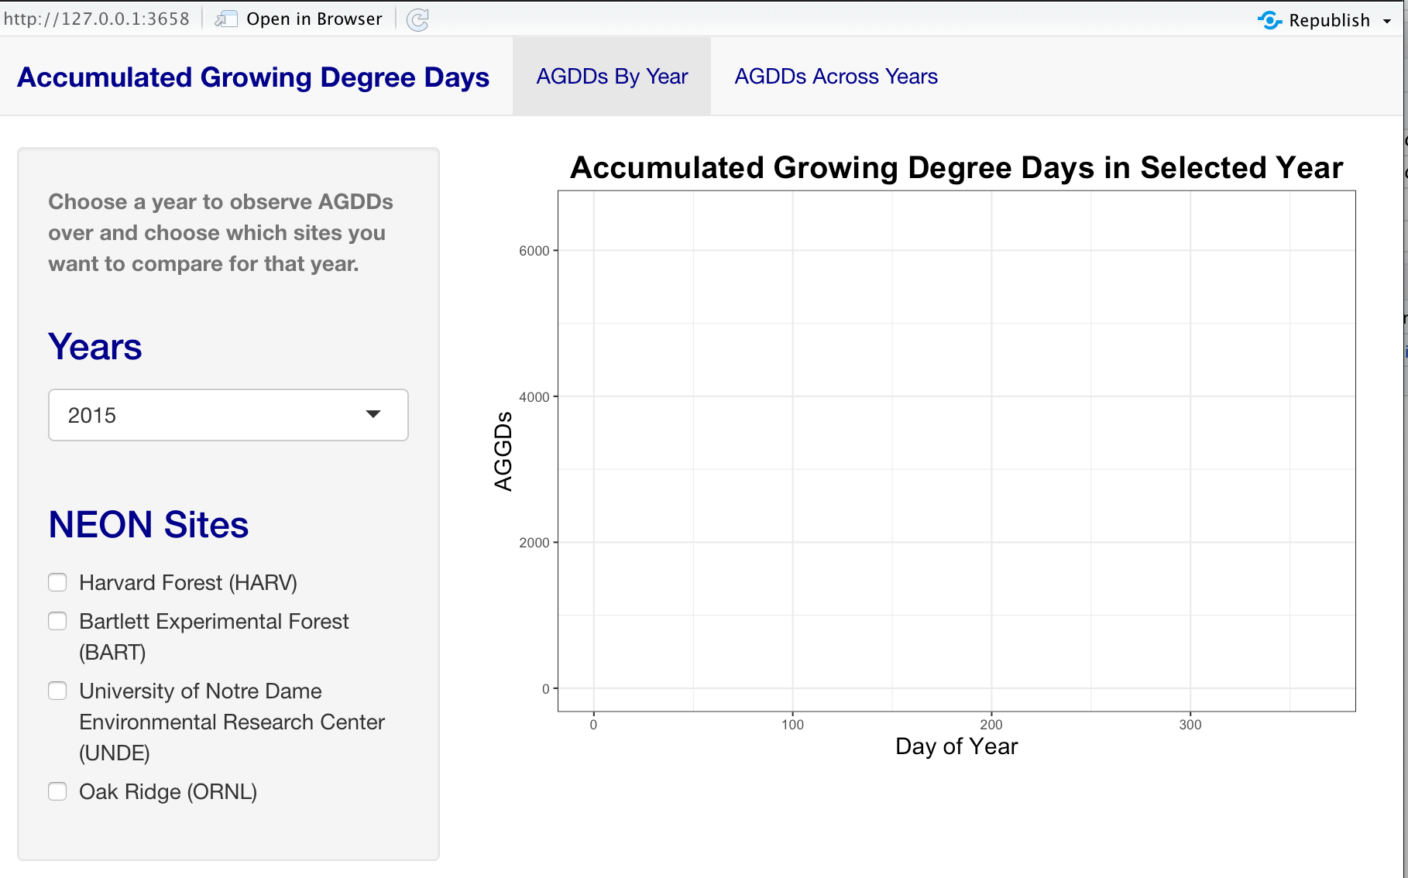
Shiny Apps
AGDD-tabsets

Slide 14
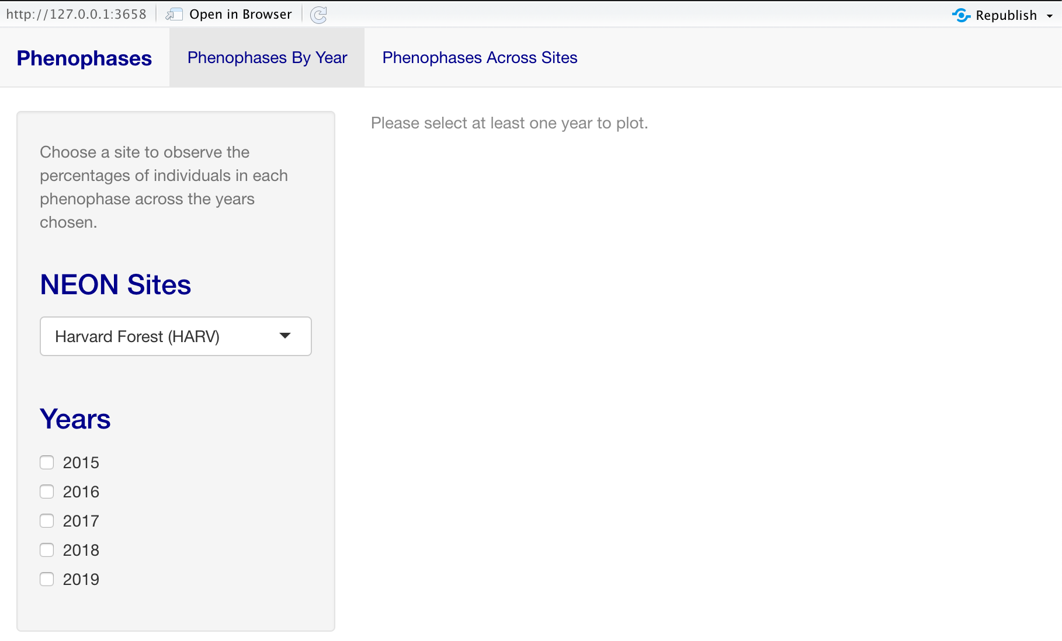
Shiny Apps
Pheno-tabs

Slide 15
Data Story Drafts

Slide 16
Final Product…so far

Slide 17
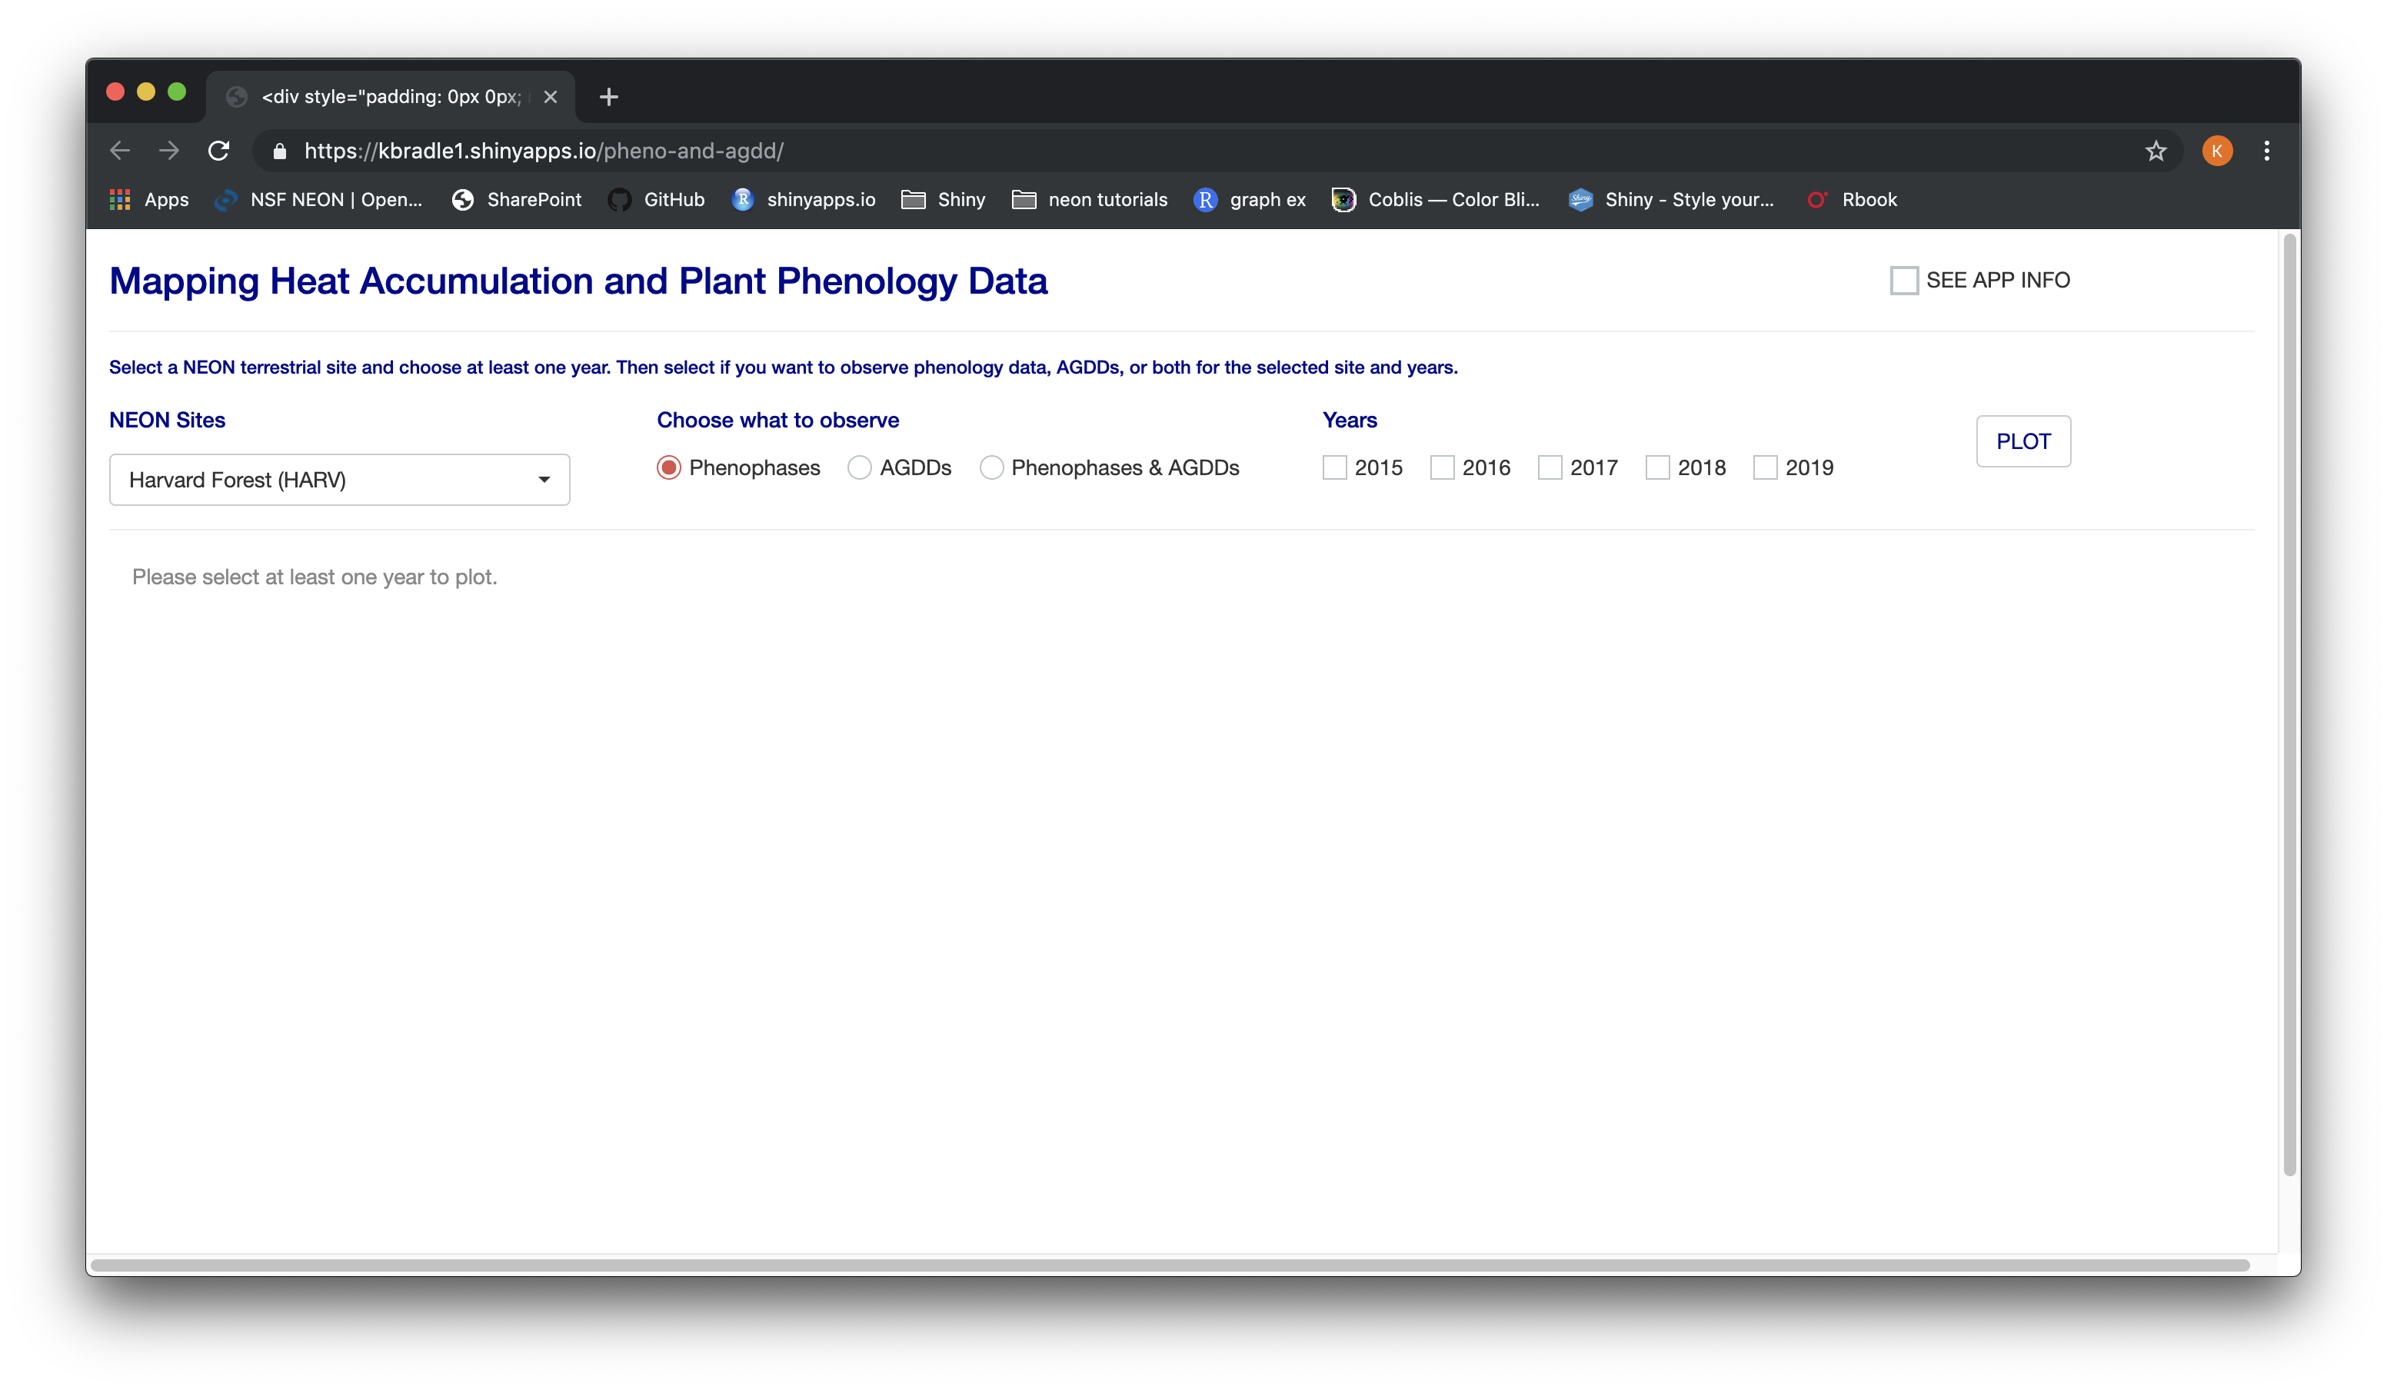
Final Product…so far
Shiny app overview

Slide 18
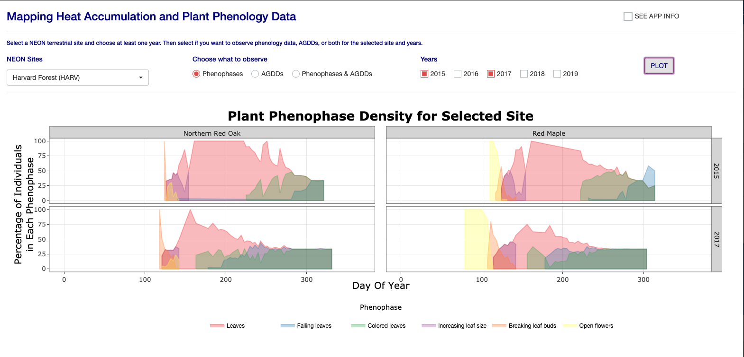
Final Product…so far
Phenophases

Slide 19
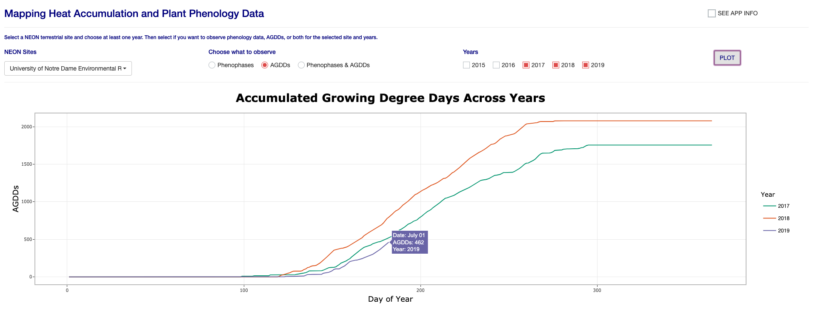
Final Product…so far
AGDDs

Slide 20
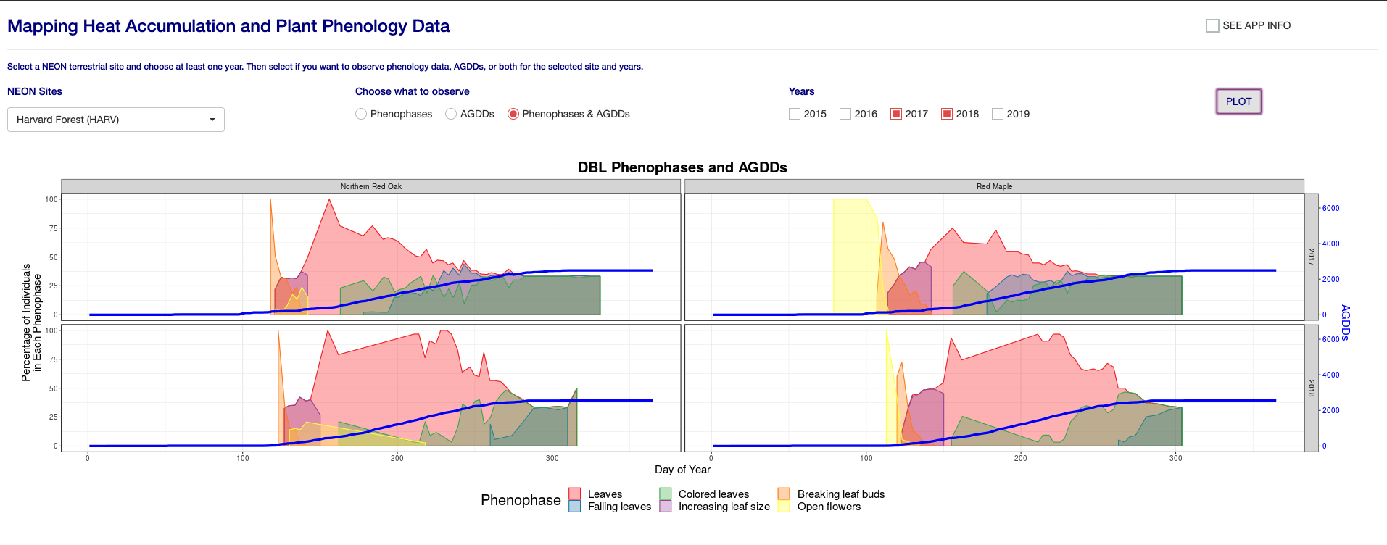
Final Product…so far
Phenophases and AGDDs

Slide 21
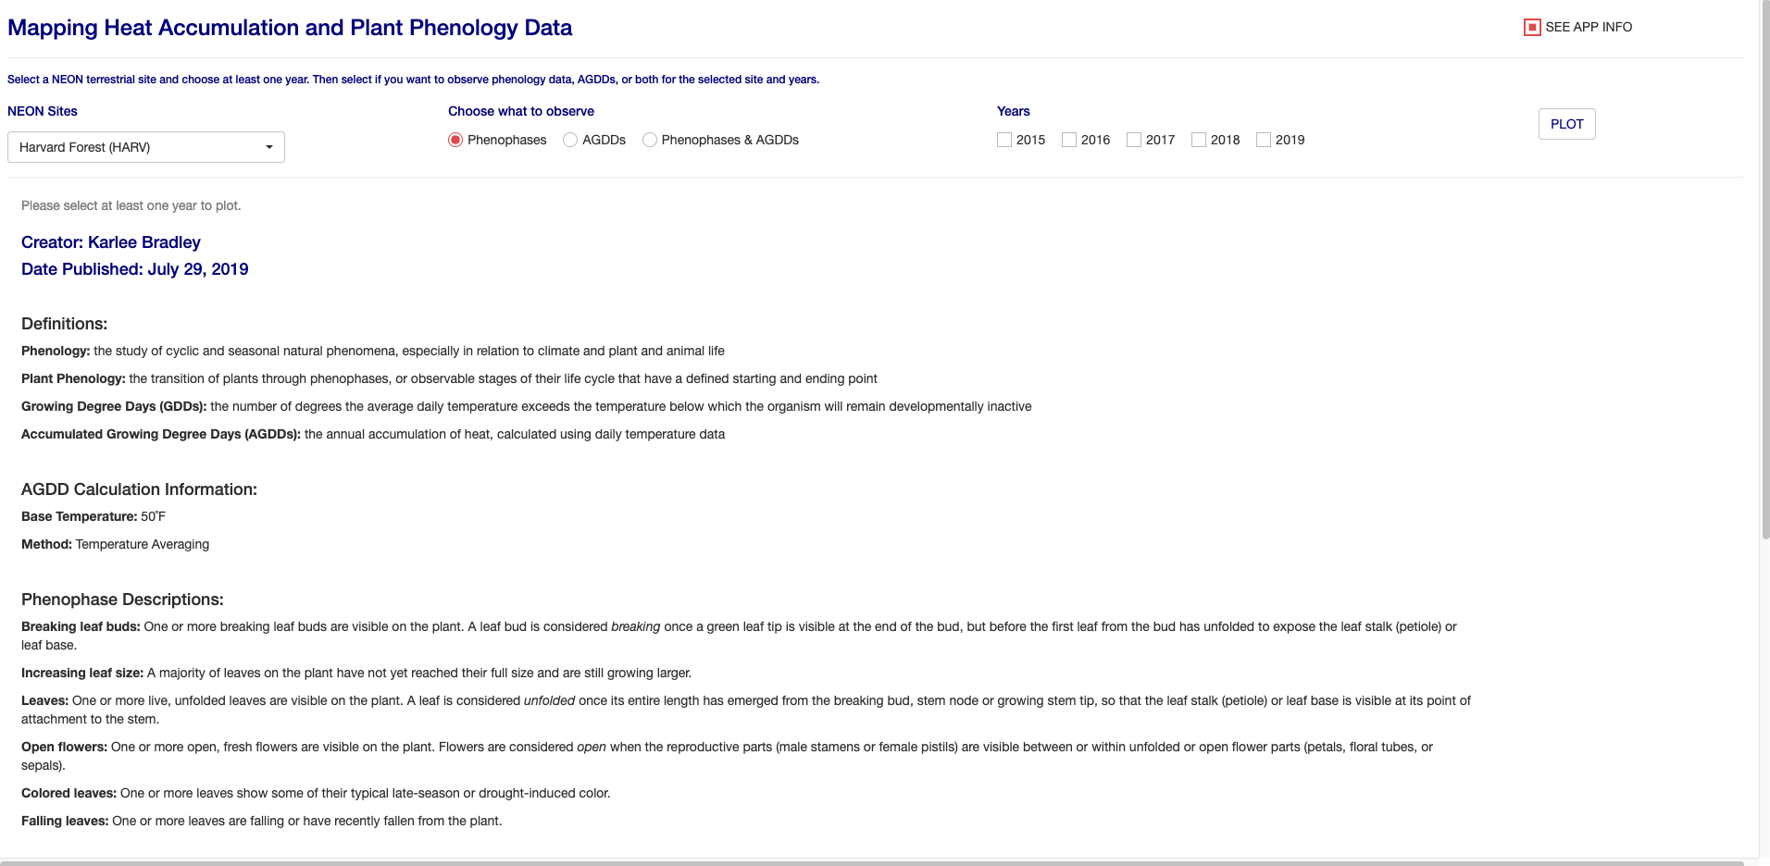
Final Product…so far
Application Info, pt. 1

Slide 22
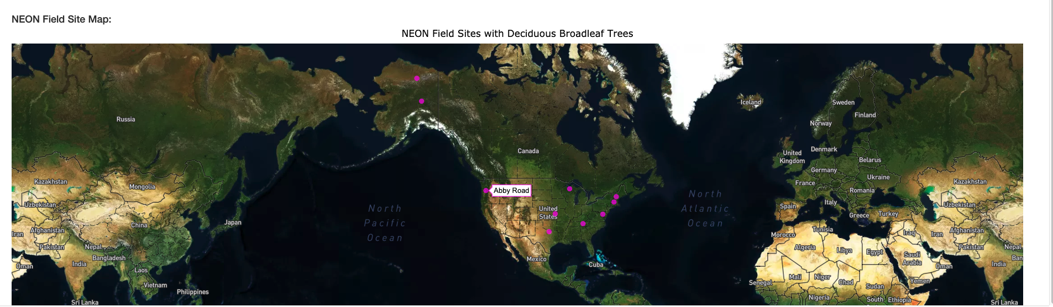
Final Product…so far
Application Info, pt. 2

Slide 23
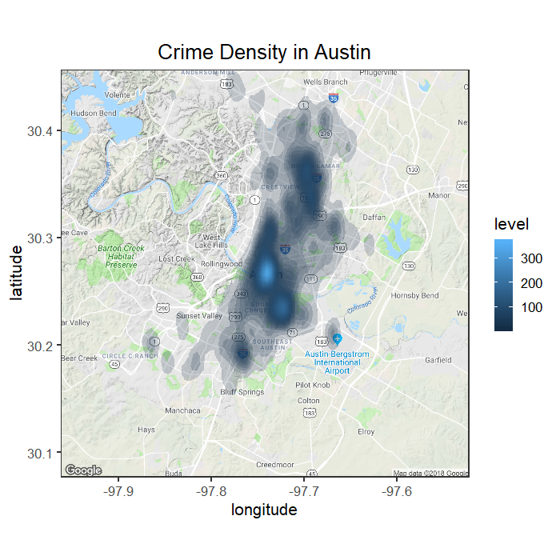
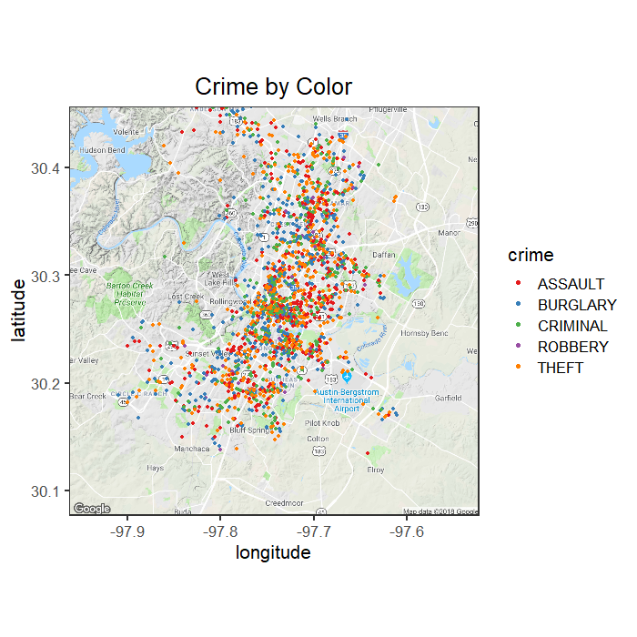
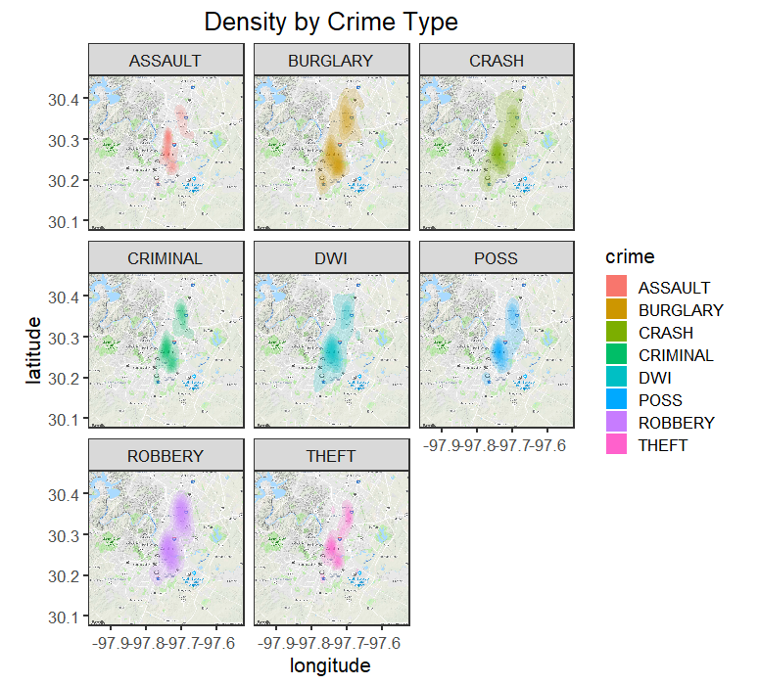
About Me!

Slide 24
About Me!

